Slide 1

Carpet, Tile, Fabric Cleaning
FOR
MUSIC CITY CENTER
RFP 101-2016

Slide 2
BEFORE WE BEGIN…
Please Sign – In
Why are we here?
Questions – WRITTEN RESPONSES PREVAIL

Slide 3
Agenda
Welcome/Introductions
Meeting Guidelines
RFP Overview and Highlights
Important Dates
Submission Requirements
Q & A Session

Slide 4
INTRODUCTIONS
Jasmine Quattlebaum – Director of Purchasing/DBE
Joe Steele – Purchasing/DBE Coordinator
DeWayne Smith – Director of Facilities
Heidi Runion – Director of Finance
Elisa Putman – Sr. VP and Chief Operations Officer

Slide 5
RFP OVERIEW AND HIGHLIGHTS
Any contract resulting from this RFP will be for a three (3) year term with a one-time option to extend for two (2) additional one year term
Contractor must be able to clean Tai Ping/Axminster carpets with a 80/20 wool blend or 100% wool using a absorbent powder compound dry cleaning process.
Approximately 400,000 square feet of carpet

Slide 6
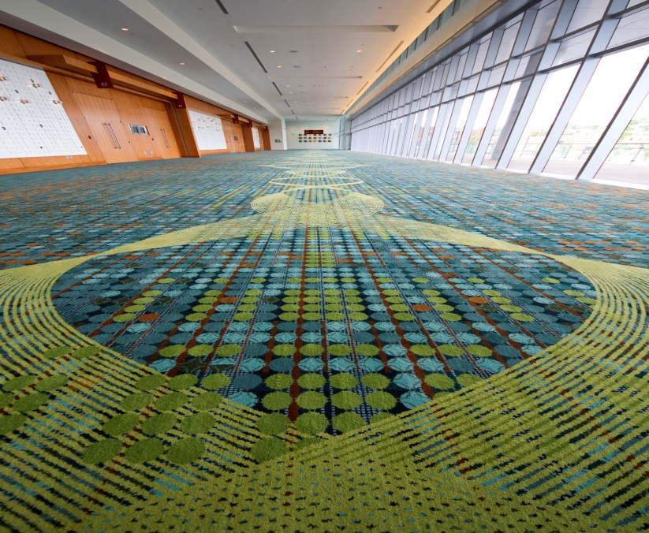
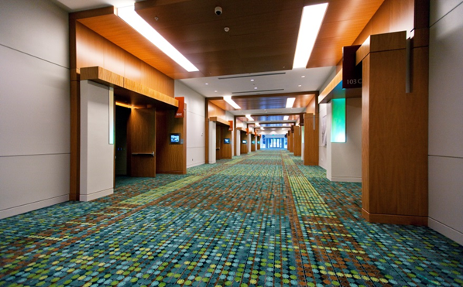
RFP OVERIEW AND HIGHLIGHTS
Davidson Ballroom Pre-function
Meeting Room Corridor

Slide 7
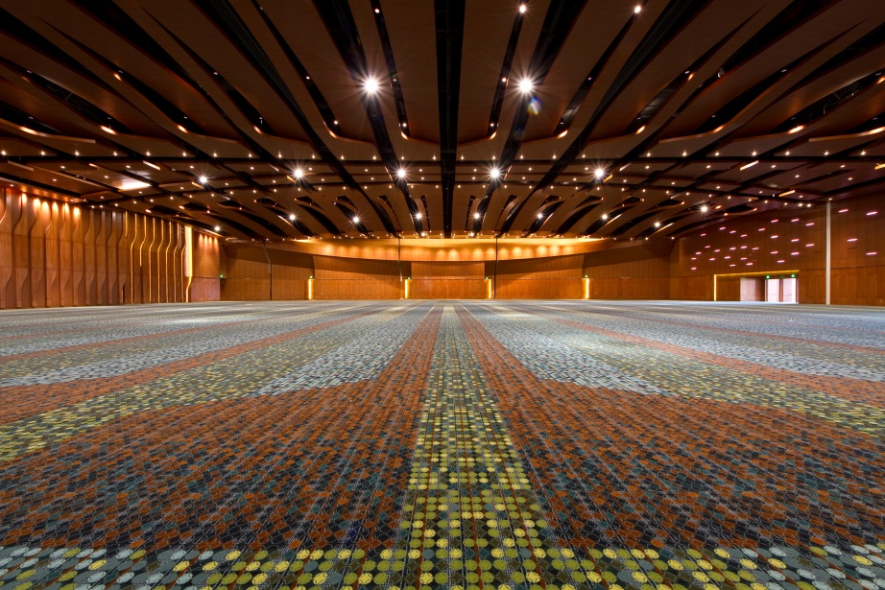
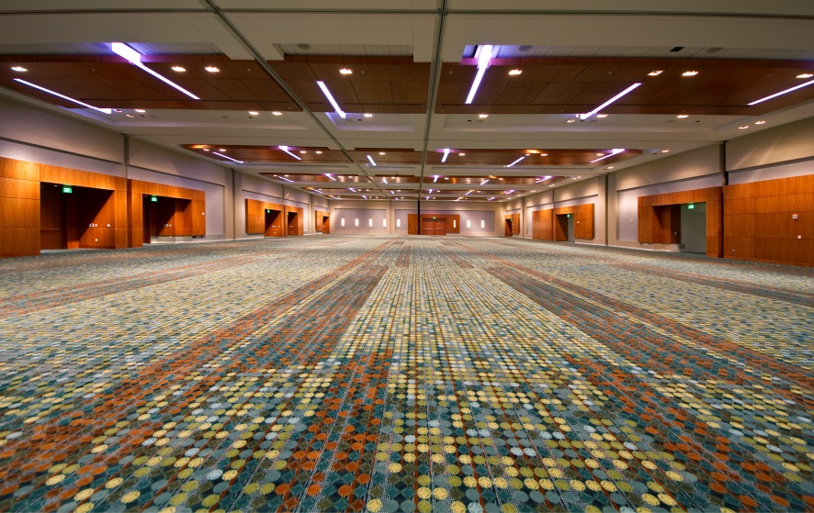
RFP OVERIEW AND HIGHLIGHTS
Grand Ballroom
Davidson Ballroom

Slide 8
RFP OVERIEW AND HIGHLIGHTS
Contractor must be able to clean floor tile and grout located in restroom and lobbies.
Contractor must also provide cleaning services for fabric wall panels located in meeting rooms.

Slide 9
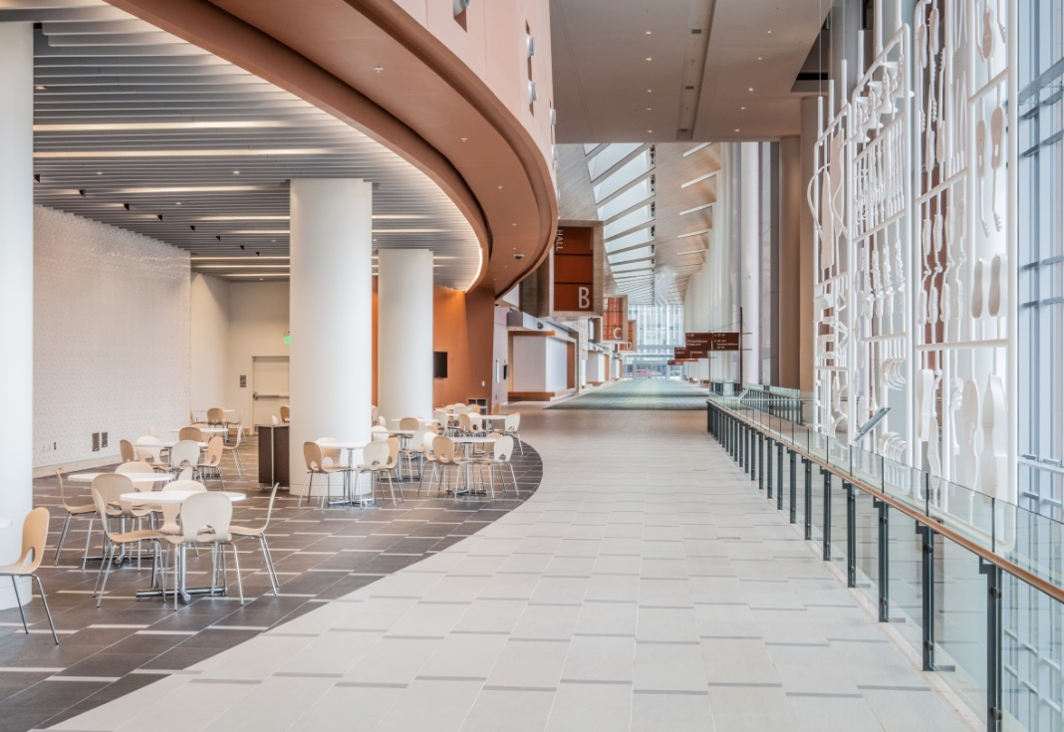
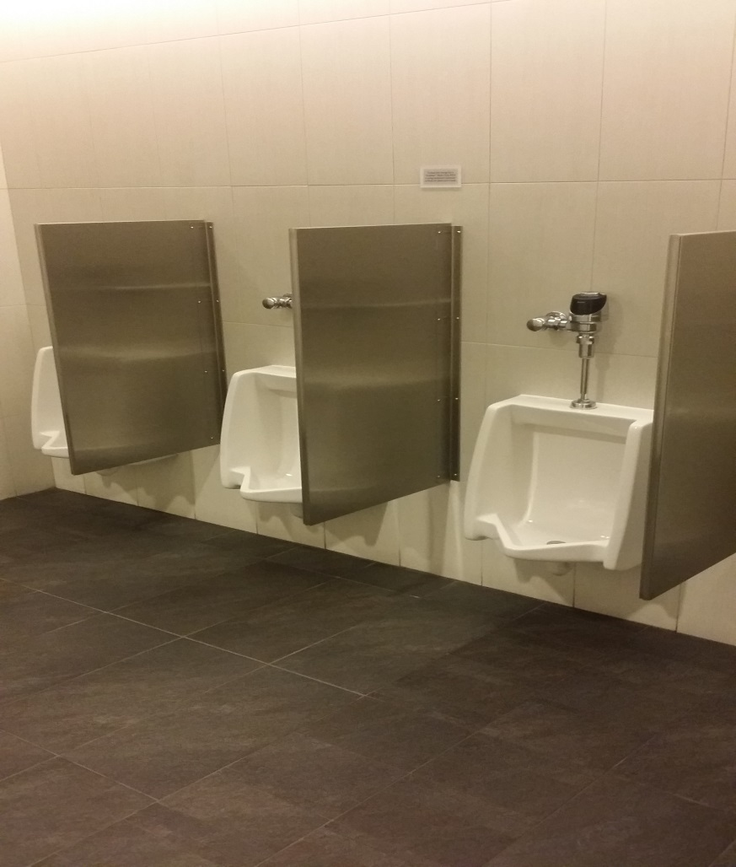
RFP OVERIEW AND HIGHLIGHTS
Food Court Area
Typical Men’s Restroom

Slide 10
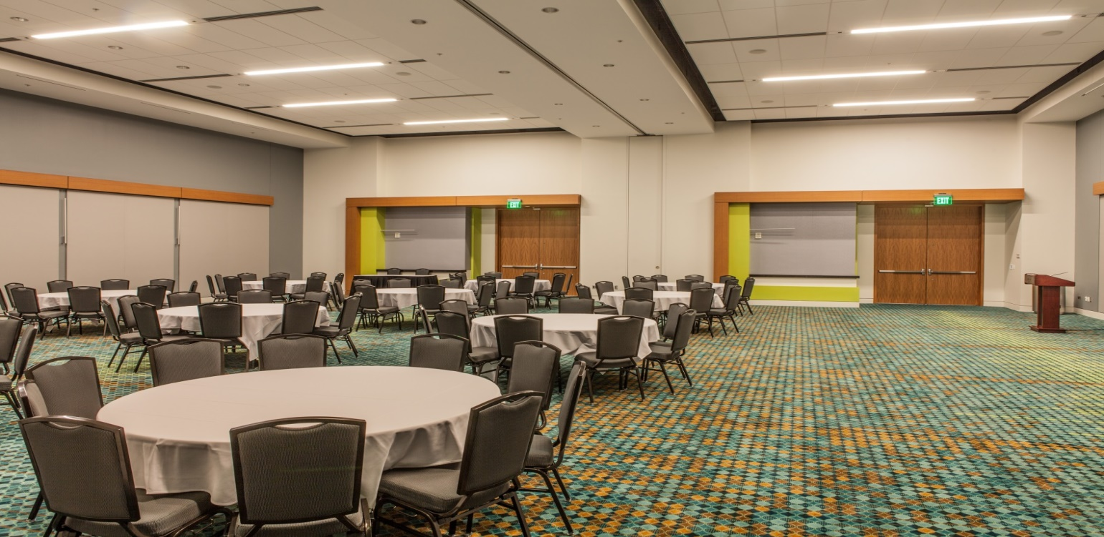
RFP OVERIEW AND HIGHLIGHTS
Fabric Walls in Meeting Rooms

Slide 11
RFP OVERIEW AND HIGHLIGHTS
Cleaning of designated areas will occur annually and typically in the month of December based on business levels.
May require some work outside this timeframe.
Must clean areas during overnight hours. Normal business hours may be available
Spot cleaning will require a 48 hours response time

Slide 12
RFP OVERIEW AND HIGHLIGHTS
Will utilize staff/crew that have been trained or certified on how to properly and safely clean all surfaces listed in RFP
Exhibit D : cleaning specifications of carpet, title, and fabric for this scope

Slide 13
DIVERSITY PLAN OVERIEW
It is the policy of the Authority to assist minority, women, small, and service disabled veteran-owned business enterprises in learning how to do business with the Authority. Furthermore, proposers are encouraged to maximize the usage of minority, women, small, and service-disabled veteran-owned businesses with respect to this scope.
Read Section II. Diversity Business Participation (10 pts)
Diversity Plan will outline the plan to achieve or exceed a target percentage of minority, woman, small businesses and/or service disabled veteran owned businesses participation.
Different ways to obtain DBE participation may be through the use of mentorships, partnerships, and using sub contractors.

Slide 14
DIVERSITY PLAN OVERVIEW CONTINUED
Work with the Director of Purchasing/DBE and the Purchasing DBE Coordinator to establish a level of DBE participation, and reporting measures to fulfill contract compliance requirements.
DBE lists are available for the specified discipline of how proposers plan to use DBE company.

Slide 15
IMPORTANT RFP DATES
RFP Questions and Inquiries Due | February 3, 2016
Responses to Inquiries | February 5, 2016
RFP Submissions Due | February 12, 2016 3:00 PM Nashville local time

Slide 16
EVALUATION CRITERIA
Experience and References
Total points available for this criterion are 35 points
Pricing (use Exhibit B and Exhibit C)
Total points available for this criterion are 35 points.
Diversity Business Plan
Total points available for this criterion are 10 points.
Availability
Total points available for this criterion are 20 points.

Slide 17
SUBMISSION REQUIREMENTS
All submittals must be received by deadline - NO EXCEPTIONS.
Hand Delivery Option: Administrative Offices
600 Koreans Veterans Blvd
UPS or FedEx Option: Music City Center House Docks
700 Koreans Veterans Blvd

Slide 18
SUBMISSION REQUIREMENTS
Read Section III D. Response Format, Requirements and Evaluation Criteria thoroughly
Include required amount of copies and electronic copy
Organize tabs in order listed in RFP
Ensure to include all required Exhibits

Slide 19
QUESTIONS?
REMINDER: Questions must be submitted in writing in order to receive an official response.
Written responses to questions will be issue by RFP amendment and posted to Music City Center website:
http://www.nashvillemusiccitycenter.com/business-opportunities

